Slide 1
AI
Spoofing and countermeasures for speaker verification
Report
Mode by :_wwj_

Slide 2
目录
CONTENT
01
03
ASV
ASV could be attacked in …
HOW
The attack is …
About ASV, we should know…
When we evaluate ASV, we use …
02
04
WHERE
WHAT

Slide 3
PART
task
accept or reject a claimed identity based on a speech sample
01
two types of ASV systems
text-dependent and text-independent
text-dependent
Assume fixed or prompted phrases
About ASV
text-independent
Operate on arbitrary utterances

Slide 4
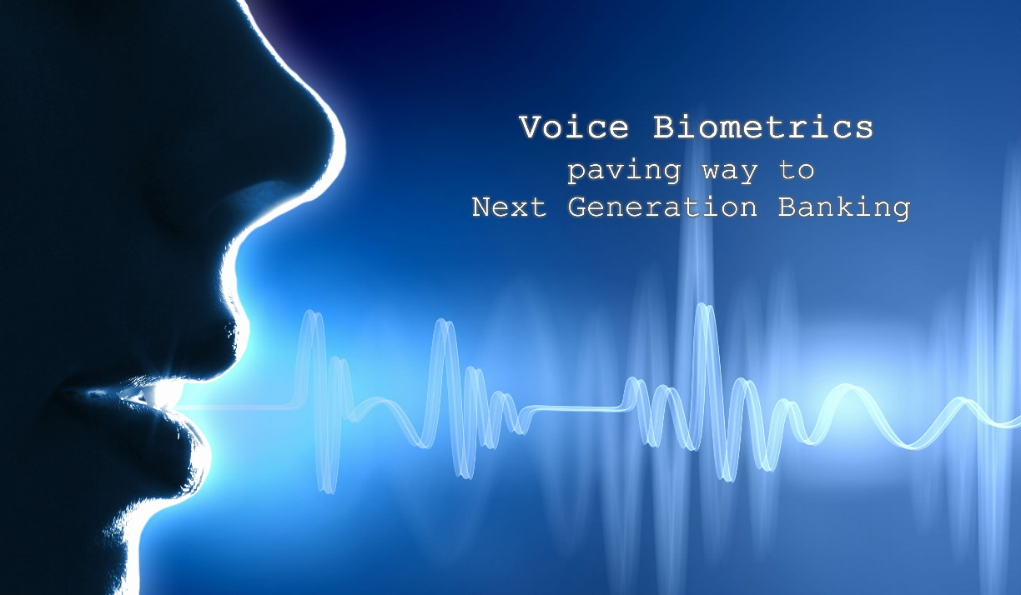
01
Feature extraction
prosodic
Prosodic features are extracted from longer segments such as syllables and word-like units to characterise speaking style and intonation
02
03
high-level idiolectal features
01
short-term spectra
High-level features are extracted from a lexicon (or other discrete tokens) to represent speaker behaviour or lexical cues.
Short-term spectral features are extracted from short frames typically of 20–30 ms duration. They describe the short-term spectral envelope which is an acoustic correlate of voice timbre.

Slide 5

01
Speaker modelling and classification
modelling the feature distribution of a target speaker
对目标说话者的特征分布进行建模
About text-dependent systems
In contrast to text -independent systems, text-dependent systems not only model the feature distribution, but also the language content.
a log-likelihood ratio (LLR) score:
(这里X为特征向量的序列)
将l和阈值进行比较来判断是选择H0(相同说话者)还是H1(不同说话者）
实现方法：
X是MFCC，声学模型用GMM(高斯混合模型)
更现代的方法，X为high-dimensional i-vectors

Slide 6
PART
two processes
offline enrolment and runtime verification
02
weaknesses
Eight such vulnerability points for a generic ASV system are also illustrated in
next PPT
ASV's process and weaknesses

Slide 7
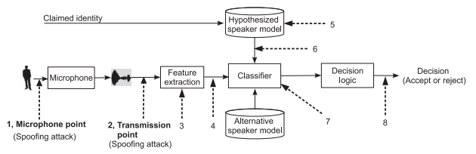
02
ASV system with eight possible attack points
These components and the links between them all represent possible attack points
In practice the sample is compared to two models, one corresponding to the hypothesised speaker and a second representing the alternative hypothesis. The classifier determines a match score which represents the relative similarity of the sample to each of the two models. Finally, the decision logic module uses the relative score (usually, a log-likelihood ratio) to either accept or reject the identity claim.

Slide 8
02
ASV system with eight possible attack points
They can be categorised as follows:
Direct attacks, also referred to as spoofing attacks, can be applied at the microphone level as well as the transmission level – labelled as attack points 1 and 2
Indirect attacks are performed within the ASV system itself – labelled as attack points 3 to 8
neither microphone level nor transmission level attacks necessarily require system-level access

Slide 9
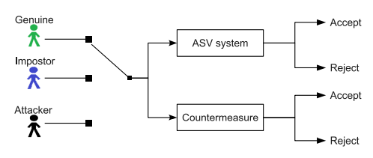
PART
Two different test
target tests and impostor tests
03
Two result
Accept and Reject
Evaluation metrics

Slide 10
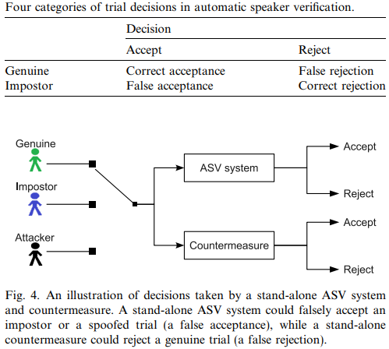
02
ASV system with eight possible attack points
There are two possible correct outcomes and two possible incorrect outcomes, namely false acceptance (or false alarm) and false rejection (or miss).
Statistics acquired from many independent tests (trials) are used to estimate the false acceptance rate (FAR) and the false rejection rate (FRR).
To prevent spoofing attacks, countermeasures have been developed to decide whether a particular trial is a licit access attempt or a spoofing attack. Ideally, countermeasures should decrease the FAR in the event of spoofing attacks while not increasing the FRR in the case of genuine access attempts.

Slide 11
PART
Four different spoofing attacks
Impersonation (generate the same voice as of the original)
Speech synthesis (text-to-speech(TTS), to read from text)
Voice conversion (convert one speaker’s voice towards that of another)
Replay attack (very easy to do, recorded voice)
04
Spoofing and countermeasures

Slide 12

01
Impersonation
有的研究认为模拟来调整自己的声音可以克服ASV，甚至是非专业的模仿者：
The work in Lau et al. (2004) showed that non-professional impersonators can readily adapt their voice to overcome ASV, but only when their natural voice is already similar to that of the target speaker
有的研究认为(专业)模仿者无法欺骗任何一种ASV系统：
A more recent study (Hautama¨ki et al., 2013a) analysed the vulnerability of both classical GMM-UBM and state-of-the-art i-vector systems to impersonation attacks.
Impersonation is one of the most obvious approaches to spoofing and refers to attacks using human-altered voices, otherwise referred to as human mimicking. Here, an attacker tries to mimic a target speaker’s voice timbre and prosody without computer-aided technologies.

Slide 13
01
ADD TOUR TITLE HERE
面临的一大问题：真人所发出的数据难以记录
Unlike the spoofing attacks discussed below, all of which can be assumed to leave traces of the physical properties of the recording and playback devices, or signal processing artefacts from synthesis or conversion systems, impersonators are live human beings who produce entirely natural speech.
伪装检测问题的解决
Interestingly, some related work (Amin et al., 2013; Amin et al., 2014) has addressed the problem of disguise detection.
摘要
we collected a database of synchronous speech and ElectroGlottoGraphic (EGG) signals from three voice impersonators each producing nine distinct voice identities And analyzed. The results demonstrate the utility of voice variability data for the development of voice disguise detection and speaker identification applications.

Slide 14
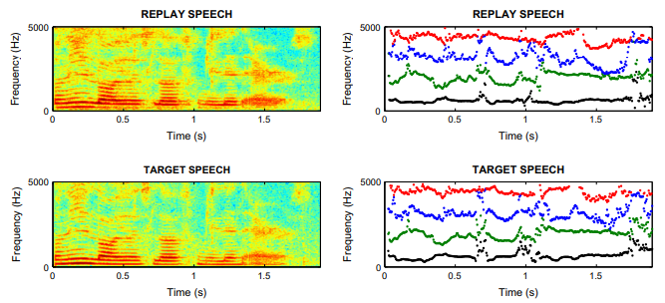
02
Replay
definition
Replay is a form of spoofing whereby an adversary attacks an ASV system using a pre-recorded speech sample collected from a genuine target speaker.
Low cost
Due to the availability of high quality and low-cost recording devices, such as smart phones, replay spoofing attack are arguably the most accessible and therefore present a significant threat.
Similarity
Figure shows that the spectrogram and
formant trajectories of the replay speech
(upper images) have a highly similarity to
those of the genuinespeech (lower images).

Slide 15
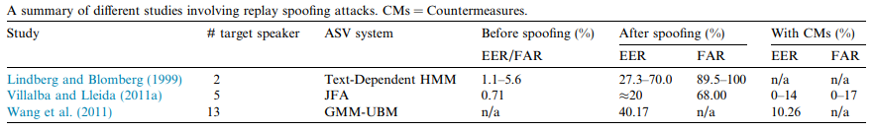
02
Replay proofing
Vulnerabilities in the context of text-independent ASV were assessed in Villalba and Lleida (2010, 2011a). Both studies used pre-recorded speech samples which were collected using a far-field microphone and then replayed in a mobile telephony scenario. Results showed that the FAR of a joint factor analysis (JFA) system increased from 0.71% to almost 68% as a result of replay attacks. Both studies involved only five speakers.
可以看到，无论使用哪种ASV系统，重播攻击都会导致FAR显着增加。

Slide 16
03
ADD TOUR TITLE HERE
使用固定密码短语的文本依赖ASV系统
The first approach to replay detection was reported in Shang and Stevenson (2010) in the context of a text-dependent ASV system using fixed pass-phrases. The detector is based upon the comparison of new access samples with stored instances of past access attempts. New accesses are identified as replay attacks if they produce a similarity score higher than a pre-defined threshold.
基于频谱比和调制指数的替代对策
An alternative countermeasure based upon spectral ratio and modulation indexes was proposed in Villalba and Lleida (2011a,b). The motivation stems from the increase in noise and reverberation which occurs as a result of replaying far-field recordings. The spectrum is flattened as a result and thus the modulation index is reduced.
基于信道噪声检测的重放攻击对策
A replay attack countermeasure based on the detection of channel noise was proposed in Wang et al. (2011). Licit recordings only contain channel noise from the recording device of the ASV system, while replay attacks incur additional channel noise introduced by both the recording device and the loudspeaker used for replay.

Slide 17
03
Speech synthesis
definition
Speech synthesis, commonly referred to as text-tospeech (TTS), is a technique for generating intelligible, natural-sounding artificial speech for any arbitrary text.
Model
前端后端两个部分组件
Typical speech synthesis systems have two main components: text analysis and speech waveform generation, which are sometimes referred to as the front-end and back-end, respectively. In the text analysis component, input text is converted into a linguistic specification consisting of elements such as phonemes. In the speech waveform generation component, speech waveforms are generated from the produced linguistic specification.

Slide 18
03
Speech synthesis proofing
ASV对基于HMM的合成语音的脆弱性
ASV vulnerabilities to HMM-based synthetic speech were first demonstrated over a decade ago (Masuko et al., 1999; Masuko et al., 2000). The work used acoustic models adapted to specific human speakers (Masuko et al., 1996, 1997) and was performed using an HMM-based, text-prompted ASV system (Matsui and Furui, 1995).
Larger scale experiments using the Wall Street Journal corpus containing in the order of 283 speakers and two different ASV systems (GMM-UBM and SVM using Gaussian supervectors) were reported in De Leon et al. (2010b), De Leon et al. (2010a) and De Leon et al. (2012a). Using a state-of-the-art HMM-based speech synthesiser, the FAR was shown to rise from 0.28% and 0% to 86% and 81% for the GMM-UBM and SVM systems respectively.
Spoofing experiments using HMM-based synthetic speech and a commercial, forensic speaker verification tool were also reported in Galou (2011) and reached similar findings.

Slide 19
03
ADD TOUR TITLE HERE
使用帧内差异作为判别特征
Most approaches to detect synthetic speech rely on processing artefacts specific to a particular synthesis algorithm. Based on the observation that the dynamic variation in the speech parameters of synthetic speech tend to be less than those of natural speech (Satoh et al., 2001) investigated the use of intra-frame differences as a discriminative feature.
用MCEP检测基于HMM的合成系统产生的合成语音
In Chen et al. (2010), higher order Mel-cepstral coefficients (MCEPs) are employed to detect synthetic speech produced by an HMM-based synthesis system. The higher order cepstral coefficients, which reflect the detail in the spectral envelope, tend to be smoothed during the HMM model parameter training and synthesis processes.
声码器和自然语音之间的声学差异
There are some attempts which focus on acoustic differences between vocoders and natural speech. Since the human auditory system is thought to be relatively insensitive to phase (Quatieri, 2002), vocoders typically do not reconstruct speech-like phase information. This simplification leads to differences in the phase spectra between human and synthetic speech, differences which can be utilised for discrimination

Slide 20
04
Voice conversion
definition
Voice conversion aims to manipulate the speech of a given speaker so that it resembles in some sense that of another, target speaker (Stylianou, 2009; Evans et al., 2014a).
difference
In contrast to speech synthesis systems which require text input, the input to a voice conversion system is a natural speech signal. Typically, voice conversion involves spectral mapping and prosody conversion. Spectral mapping relates to voice timbre, while prosody conversion relates to prosodic features, such as fundamental frequency and duration.

Slide 21
04
Voice conversion proofing
使用联合密度GMM和单位选择方法进行语音转换
The work in Kinnunen et al. (2012) and Wu et al. (2012b) extended the study of GMM-UBM systems to consider an array of different approaches to ASV. The work was performed on the 2006 NIST SRE dataset using both joint-density GMM and unit selection approaches to voice conversion. Even if converted speech could be detected easily by human listeners, experiments involving six different ASV systems showed universal susceptibility to spoofing.
i-vector，GMM-NAP和HMM-NAP系统的脆弱性
The work in Kons and Aronowitz (2013) examined the vulnerability of several state-of-the-art text-dependent systems, namely, i-vector, GMM-NAP and HMM-NAP systems. Among the three systems, HMM-NAP employed a speaker-independent hidden Markov model (HMM) instead of a GMM to capture temporal information.

Slide 22
04
Voice conversion countermeasures
借鉴语音合成
Voice conversion bears some similarity to speech synthesis in that some voice conversion algorithms employ vocoding techniques similar to those used in statistical parametric speech synthesis (Zen et al., 2009). Accordingly, some of the first work to detect converted speech drew on related work in synthetic speech detection (De Leon et al., 2011).
利用声码器引入的伪像
The work in Wu et al. (2012a) exploited artefacts introduced by the vocoder as a means of discriminating converted speech from natural speech. Cosine normalised phase (cos-phase) and modified group delay phase (MGD-phase) features were shown to be effective.
使用发声级动态语音可变性
The work in Alegre et al. (2012b) and Alegre et al. (2013b) assessed an approach to detect both voice conversion attacks which preserve real-speech phase (Matrouf et al., 2006; Bonastre et al., 2007) and artificial signal attacks (Alegre et al., 2012a). Results in Alegre et al. (2012b) suggest that supervector-based SVM classifiers are naturally robust to artificial signal attacks whereas the work in Alegre et al. (2013b) shows that voice conversion attacks can be detected effectively using estimates of utterance-level, dynamic speech variability.

Slide 23
END

